Slide 1

TIC TAC TOE
XOXO GAME
AUTHORS : COFFIE BOAFO KOFI GABRIEL & EMMANUEL MENSAH

Slide 2

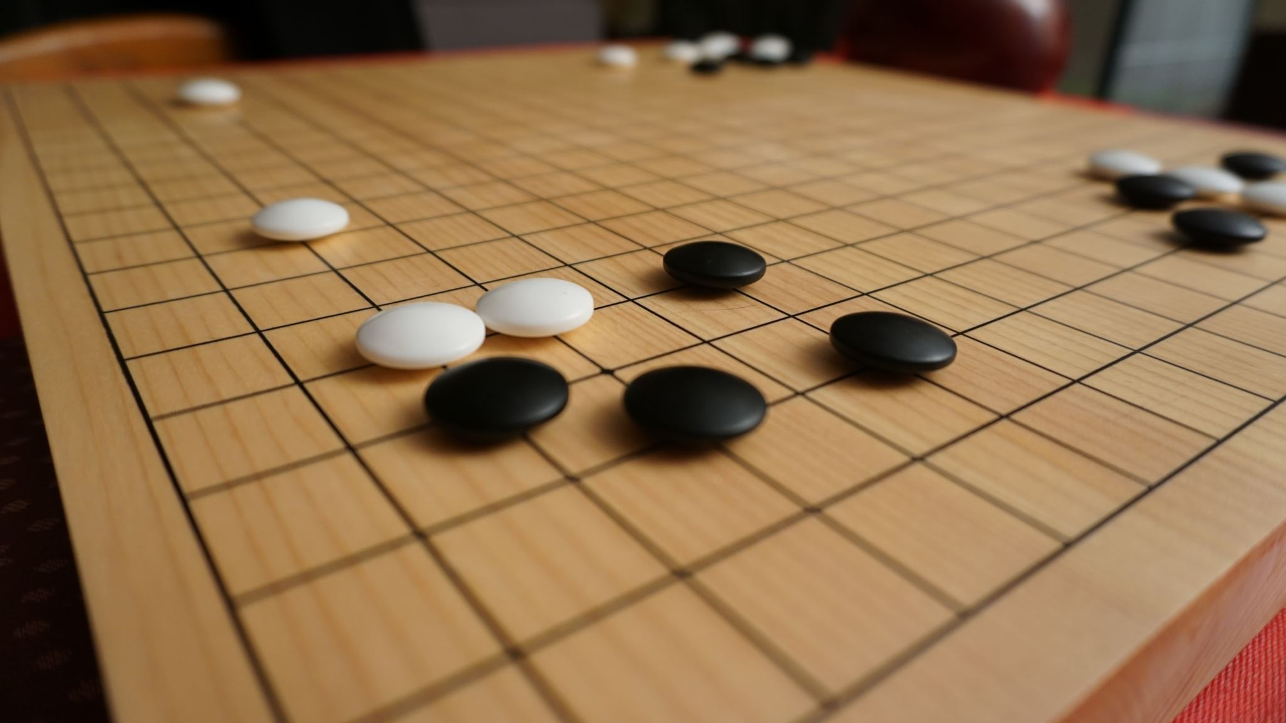
Brief idea about the game
The Tic Tac Toe(XOXO) is a simple two game player played on a 3x3 grid. It has two Characters X and O. It can be played in a single game mode with the computer, a muti player game mode, and two Computer Game plays.
But in this Project, we are going to use the option for the 2computer Game players, and it is 2-thread player X and Player O no collision and print the board every time X and O is inside mutex_lock

Slide 3
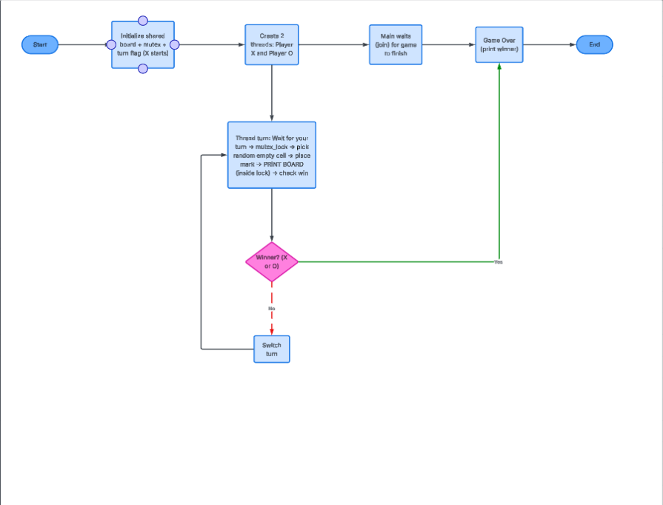
The game design

Slide 4
The player header file and the .cpp file
Player.h
Private:: string name
char symbol
Public :: Player();
Player(symbol, name);
Getters for the player's name;
Getters for the player symbol;
Setters for the Player name;
Setters for the Player Symbol;
Player.cpp
Define the functions declared in the header file
Player();
Player(symbol, name);
Getters for the player's name;
Getters for the player symbol;
Setters for the Player name;
Setters for the Player Symbol;

Slide 5
The board header and the .cpp file
Board.h
Private :: grid;
size;
Public :: Board ();
The Display board function;
The MakeMove function;
The CheckWin function;
The isFull function;
The Reset function
Board.cpp
Define the functions in the header files and write loops and if statements
Board ();
The Display board function;
The MakeMove function;
The CheckWin function;
The isFull function;
The Reset function

Slide 6
Main .cpp file
The Thread function for a Player
Try Random Moves until Successful
Lock mutex
Makes the game lag for some seconds (Optional)
Check for Winner
Create Players
Create the Game Board
Display Board
Shared Data for threads
Launch thread for Player X and Player O
Wait for both threads to finish

Slide 7
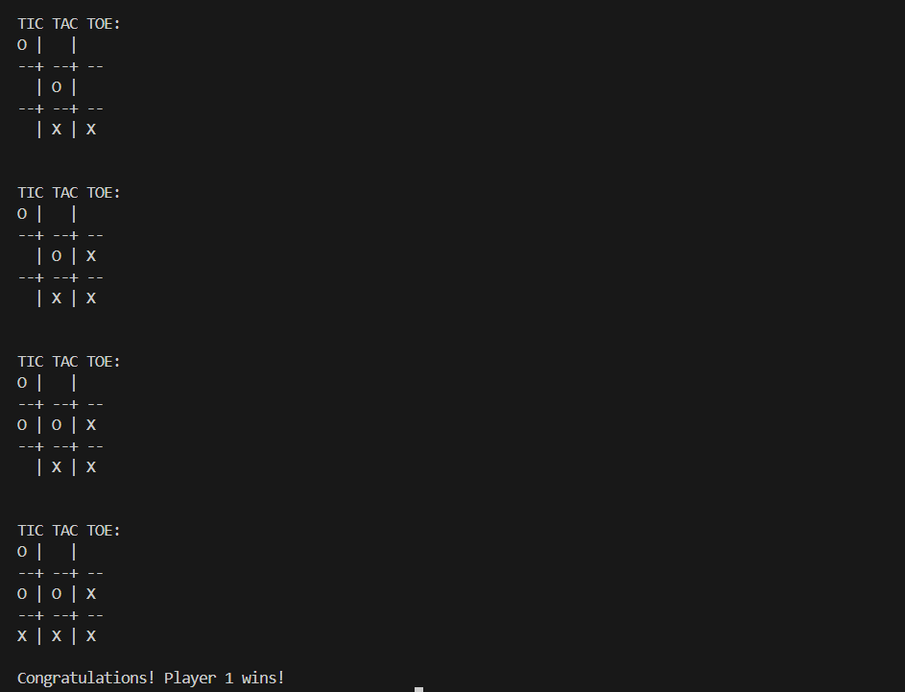
Output of the program
After all codes in files are correct and compiled using the command
g++ main.cpp board.cpp player.cpp –o xoxo
./Xoxo to run the program
Program was Successful !

